Slide 1


Slide 2
DIRECTORY LISTING

Slide 3
TABLE OF CONTENTS
Here’s what we’ll be covering in this presentation:
What is Directory Listing?
An Example of Directory Listing.
Methods to check for open directories.
Disabling Directory listing.
Mitigation.
References.

Slide 4

WHAT IS DIRECTORY LISTING
Directory listing is an option available to web servers ( IIS, Apache tomcat etc) to expose the files in web browser.
aka OPEN DIRECTORY
This indexing or listing directly can’t be tagged as vulnerable until a sensitive file is exposed without any control to the unknown user
It is dangerous to leave this function turned on for the web server because it leads to information disclosure.

Slide 5
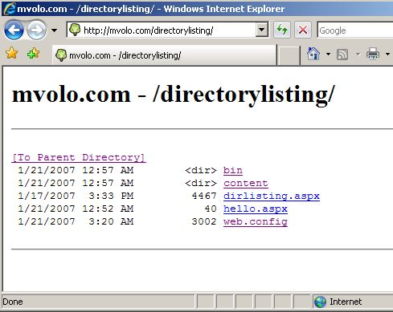

Slide 6
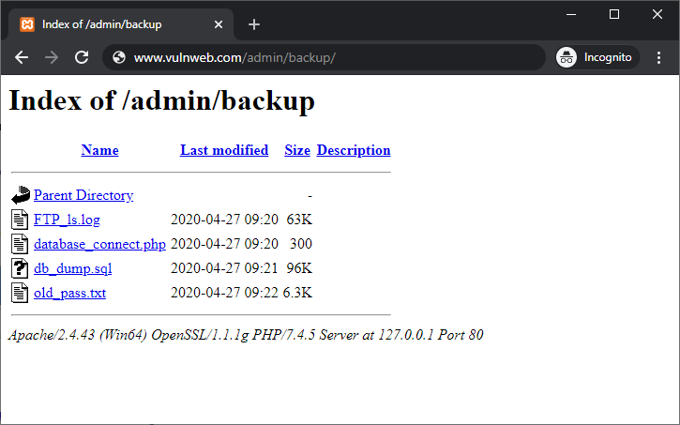

Slide 7
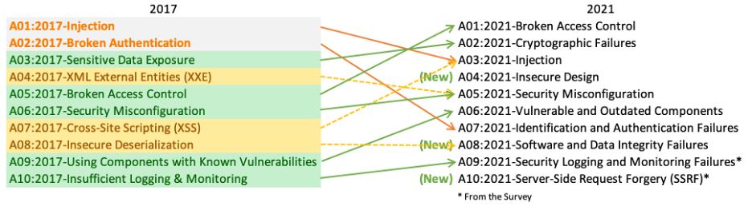
OWASP TOP 10 WEB-APPLICATION SECURITY RISKS

Slide 8
METHODS
GOOGLE DORKING
BURPSUITE
Or, spider the website using Burpsuite or any other scanning tool
Firstly, you may use Google dorks to find the open directories;

Slide 9
IMPACT
Exposing the contents of a directory can lead to an attacker gaining access to source code or providing useful information for the attacker to devise exploits, such as creation times of files or any information that may be encoded in file names. The directory listing may also compromise private or confidential data.

Slide 10
DISABLING DIRECTORY LISTING
You can disable directory listing by creating an empty index file (index.php, index.html or any other extension your web server is configured to parse) in the relevant directory.

Slide 11
MITIGATION
1
Configure your web server to prevent directory listings for all paths beneath the web root
Place into each directory a default file (such as index.htm) that the web server will display instead of returning a directory listing.
2

Slide 12
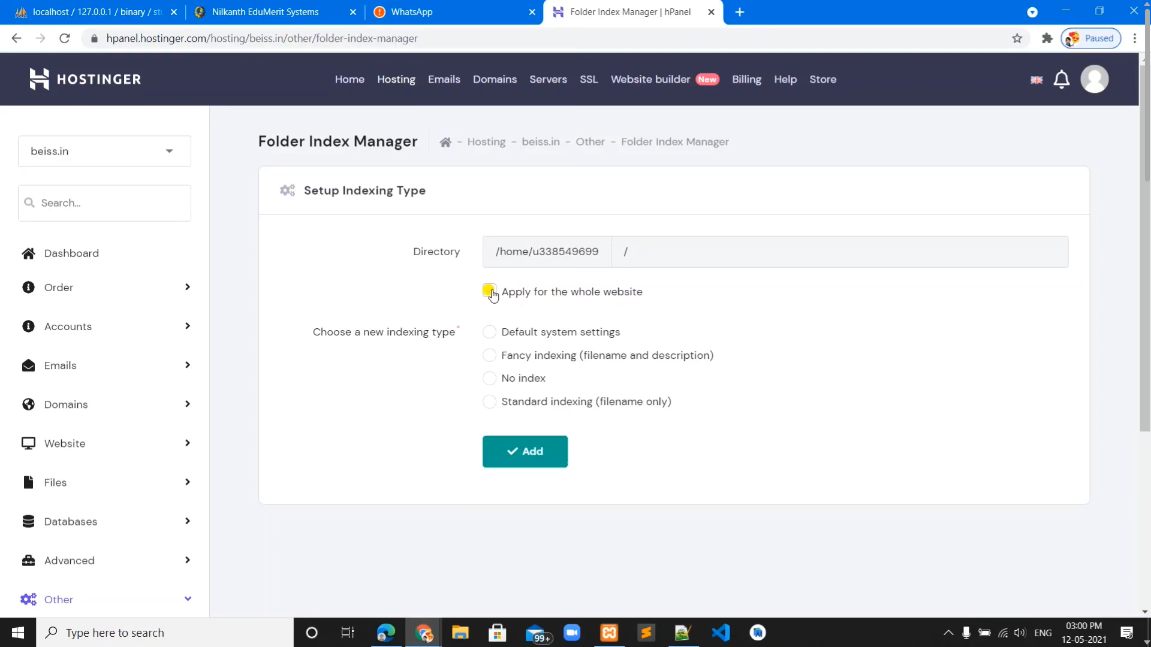


Slide 13
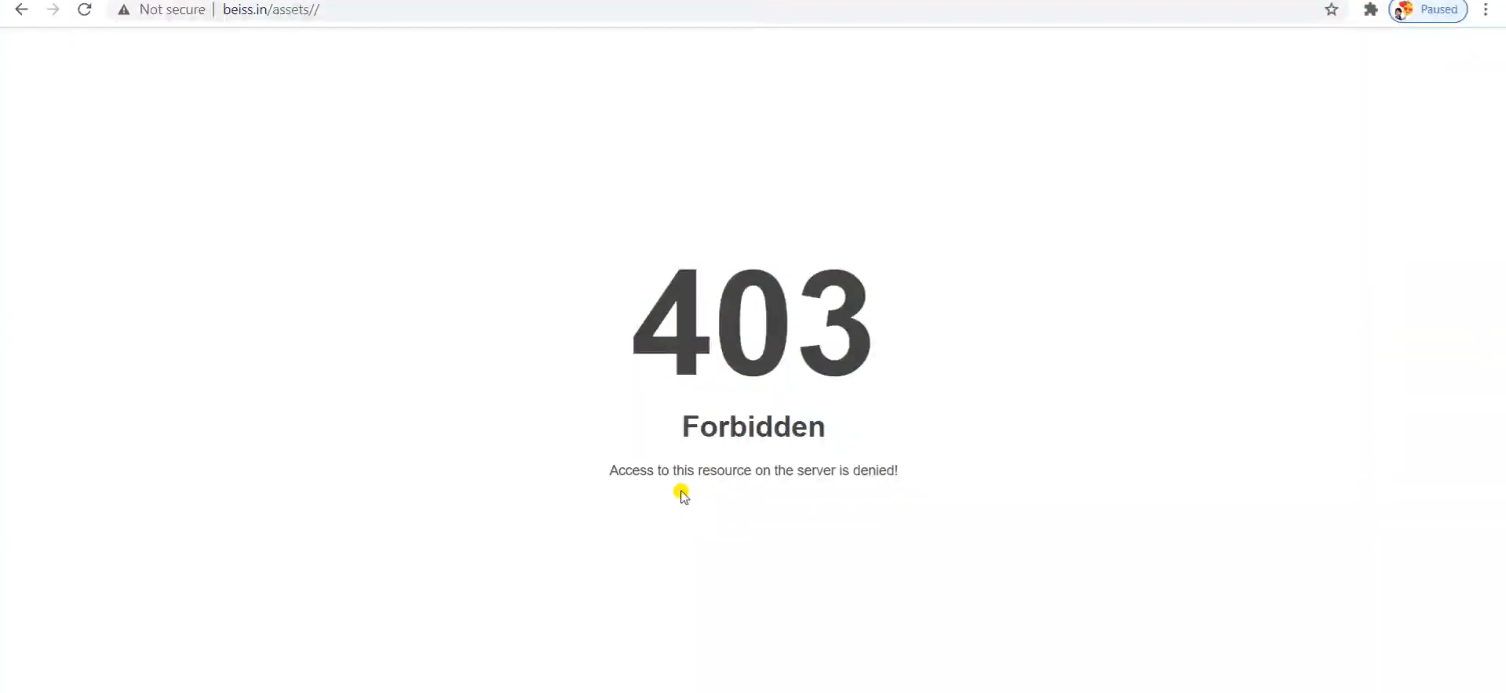

Slide 14
RESOURCES
https://www.drmarketing.io/understanding-directory-listings
https://www.socinvestigation.com/directory-listing
https://www.acunetix.com/blog/articles/directory-listing-information-disclosure/
https://www.invicti.com/blog/web-security/disable-directory-listing-web-servers/
https://www.ibm.com/docs/ssw_ibm_i_73/rzaie/rzaieconfigdirectoryin.htm
https://portswigger.net/kb/issues/00600100_directory-listing
https://www.httpcs.com/en/directory-indexing-vulnerability
https://www.httpcs.com/en/directory-indexing-vulnerability
https://amirootyet.com/post/directory-browsing-vulnerability/

Slide 15
THANKS!

